Slide 1
Welcome to 7th grade Science
Ms Toal

Slide 2
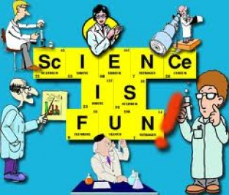
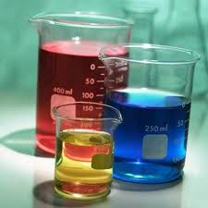
7th grade Science @ EAMS

Slide 3
7th grade science is busy!
1st trimester:
Metrics
Matter: mass, volume, density
States of Matter
2nd trimester:
Chemistry
3rd trimester:
Geology
Health Education

Slide 4
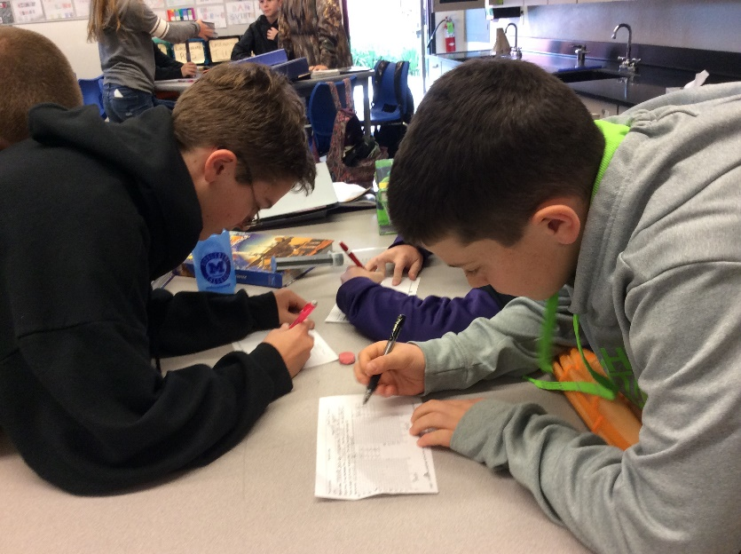
Lab Groups
Groups of 4 (5).
Table groups for 6 weeks
You will USUALLY be assigned a new seat at a different table throughout the year unless there are ISSUES.

Slide 5
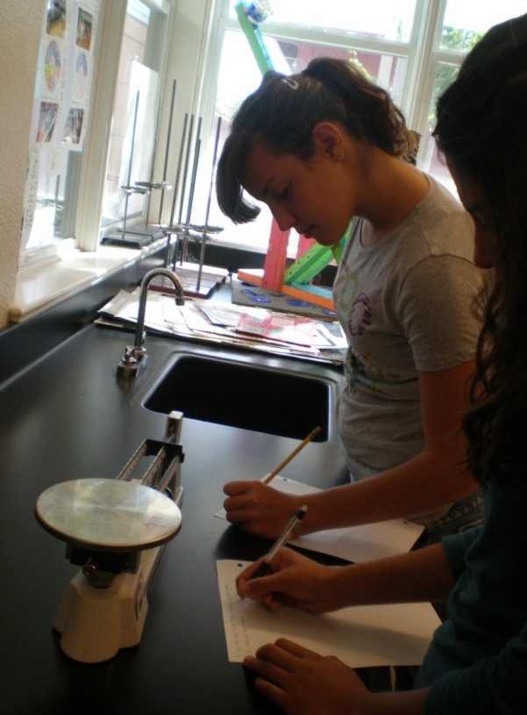
Matter Unit - measurements

Slide 6
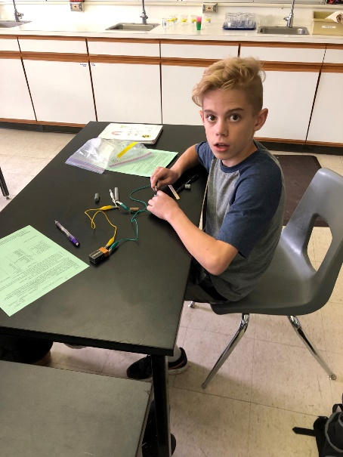
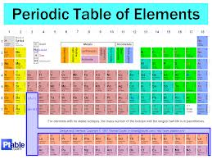
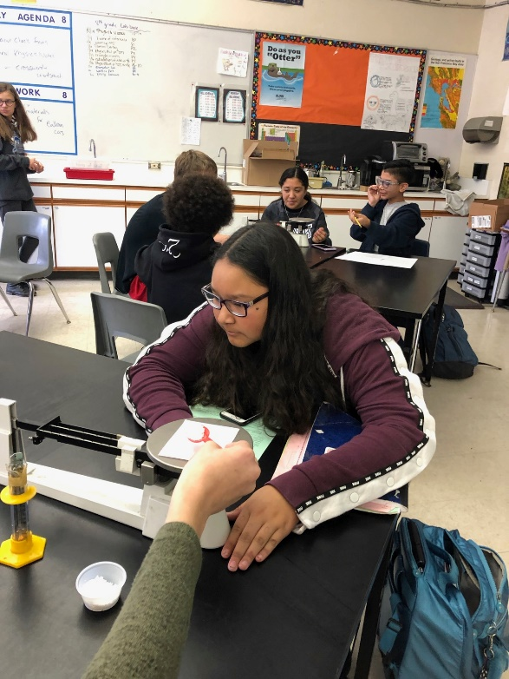
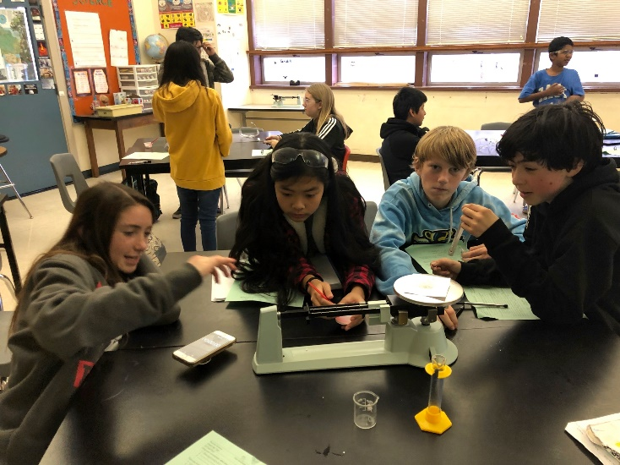
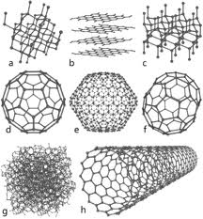
Chemistry unit

Slide 7
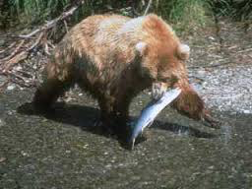
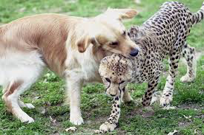
Ecology unit

Slide 8
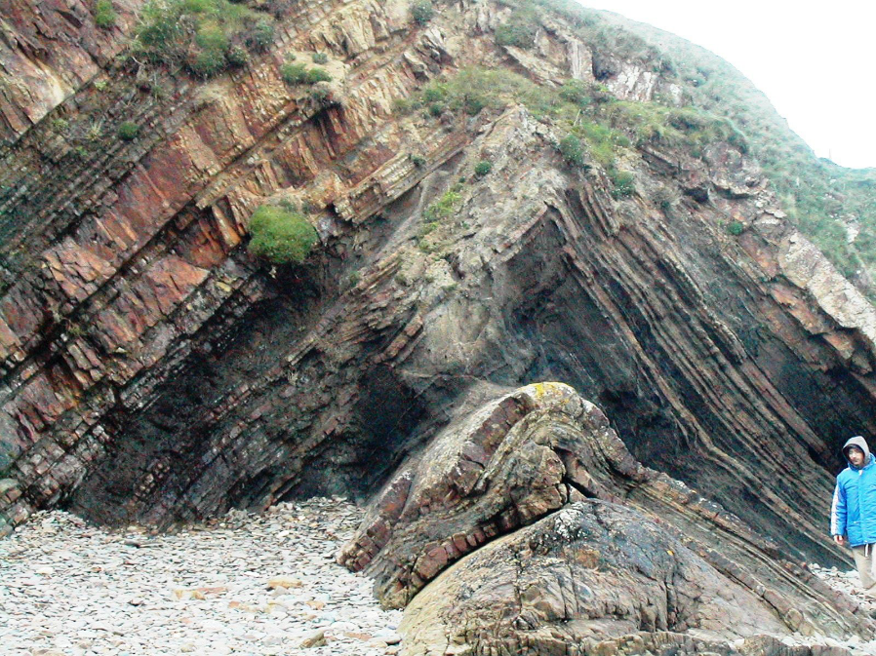
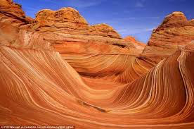
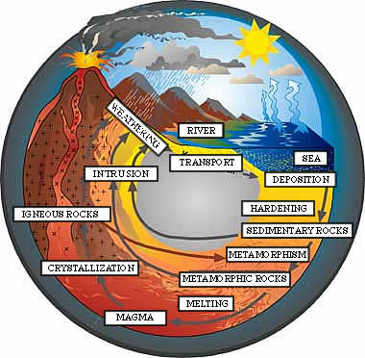
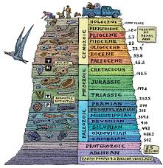
Geology unit

Slide 9
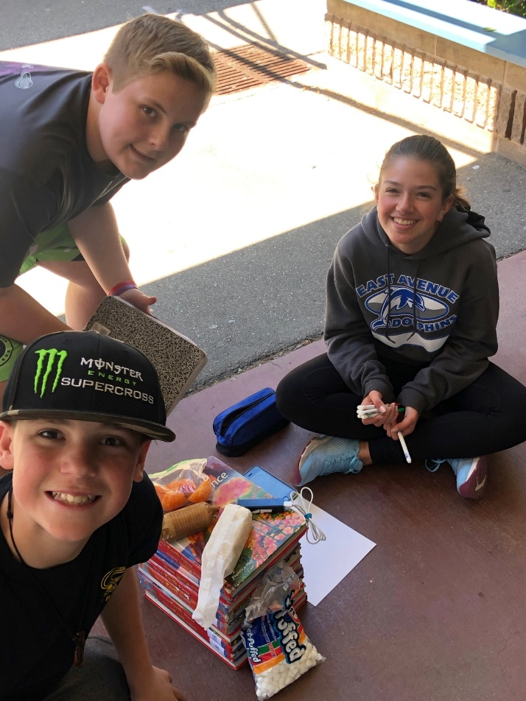
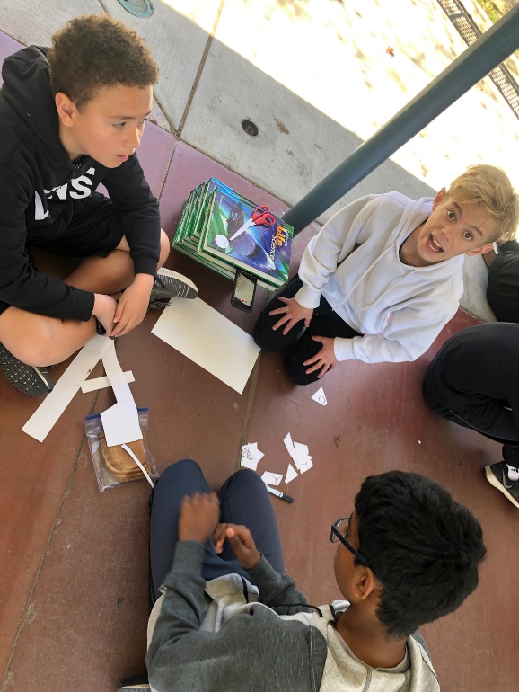

Slide 10
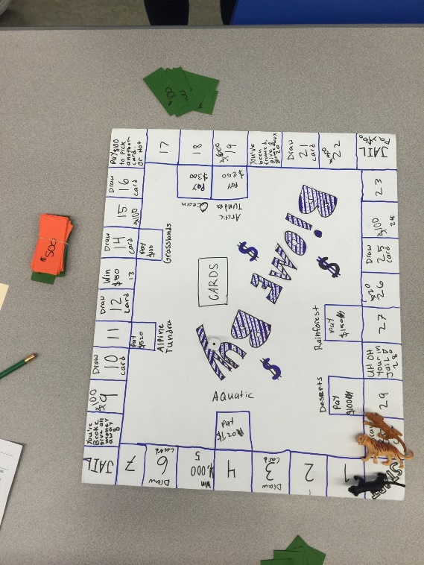
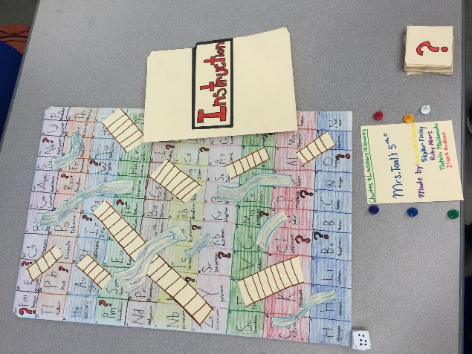
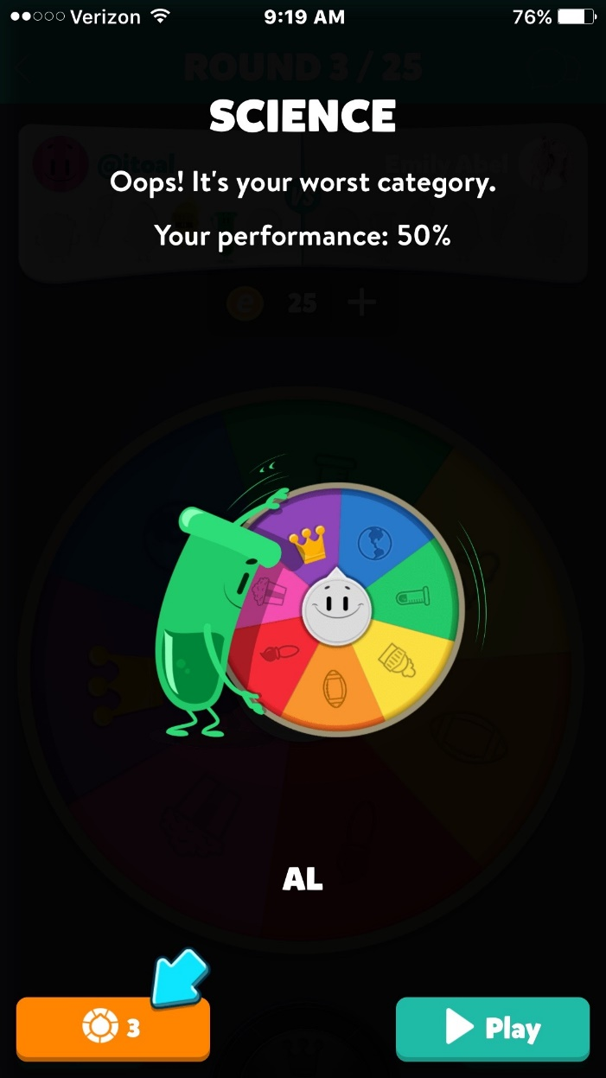

Slide 11
Grades
Check Schoology daily
Late homework won’t be accepted.
Late labs and late classwork will be marked down.
Please stay in touch via email – please give 1 day – 48 hours to respond.

Slide 12
Missed labs due to absences
There are no make up labs
If a lab is missed, you are still required to understand the concept from the lab.
You need to come see me about a missed lab. You will receive the lab sheet and will need to copy data from your table group.
AND…. you NEED to go to my website and Schoology to get caught up while you are resting at home.

Slide 13
How is science taught?
Lab book notes
text book reinforcement
Hands-on activities and labs
Traditional tests and quizzes (no retakes!)
Artwork – format, cut and measure
Chromebook research and design
Keep your lab book organized – donot throw or recycle any science work

Slide 14
Use your digital resources!
www.mstoal.com
Use it if your absent (daily agenda)
Use it if you aren’t sure of your homework (daily agenda; HW) or when an assignment is due
Use Schoology to check your grades and double check my comments after submitting assignments.

