Slide 1
States of Matter

Slide 2
Solids
have definite shape and volume
particles closely locked in position and can only vibrate.

Slide 3
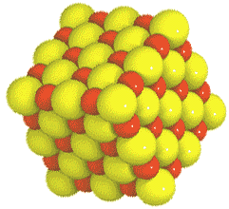
Crystalline Solids –particles form a regular, repeating pattern.
EX – table salt, snowflakes (No two snowflakes are EVER the same).

Slide 4
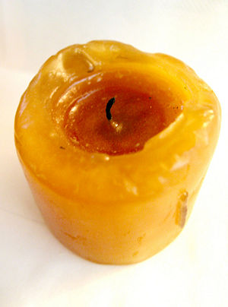
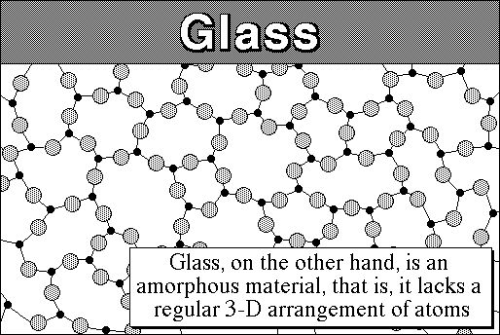
AMORPHOUS Solids
Particles that are not arranged in a regular pattern
EXAMPLE:
plastics

Slide 5
Liquids
Have definite volume but NO definite shape
Particles are more loosely connected and can collide with and move past one another
not held together as tightly as the solid
takes the shape of the container.

Slide 6
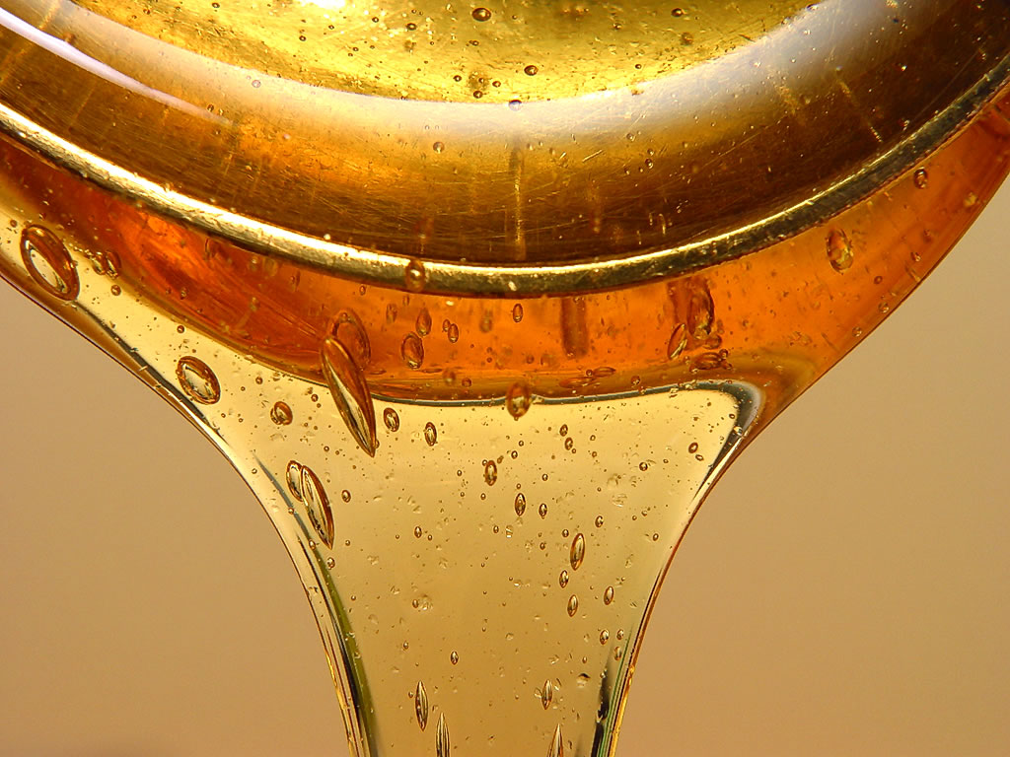
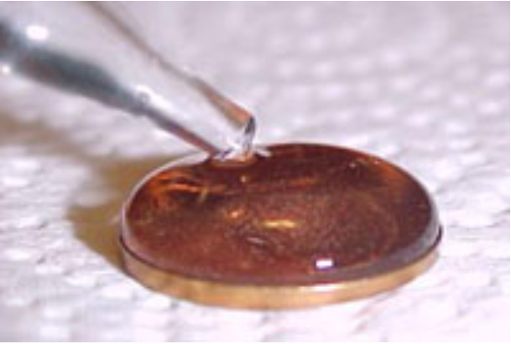
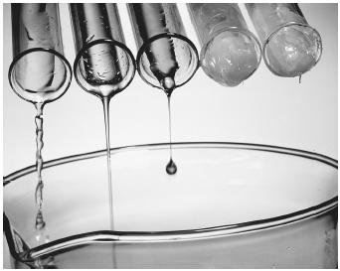
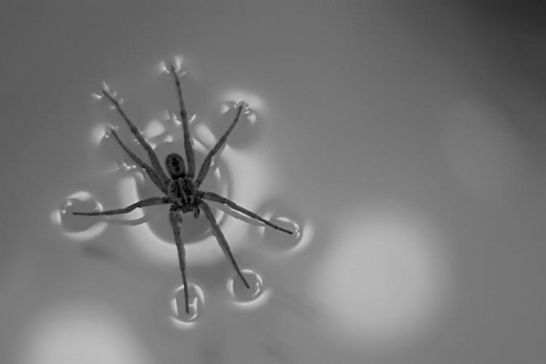
SURFACE TENSION:
result of an inward pull among the molecules that brings the molecules on the surface closer together
VISCOSITY
liquid’s resistance to flow
molasses: high viscosity
water: low viscosity

Slide 7
Gas
Change volume easily
NO definite shape or volume.
Atoms and molecules are free to move independently, colliding frequently
It can change volume very easily
Gas particles fill the space in a container,
They tend to spread far from one another, they can be pushed close together, squeezing creates pressure.

Slide 8
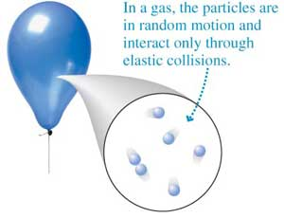
It can change volume very easily
Gas particles fill the space in a container,
They tend to spread far from one another, they can be pushed close together, squeezing creates pressure.

Slide 9
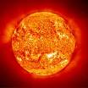
Plasma – highest energy state - more than gas
rare on Earth.
Most common phase of matter in the universe.
Extremely high in energy.

Slide 10
The End

