Slide 1
Notes on Density
By Ms Toal

Slide 2
Density
Unknown substances:
units:
Formula=
You can determine the identity of a substance by its density
g/ml or g/ cm³
Density = mass
volume
D= M
V

Slide 3
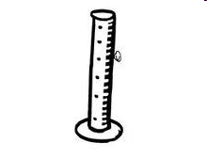
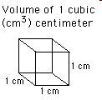
Density of water
Weight of water
All other matter
Conversions
1 ml fresh water (4ºC) weighs 1 gram.
is based relative to this density.
1 cm³ = 1 ml = 1 g

Slide 4
Float or Sink
The density of water
Anything with a density that is LESS than 1.0 g/ml
Anything with a density that is MORE than 1.0 g/ml
Let’s look at clay…
is 1.0 g/ml
will FLOAT
will SINK

Slide 5
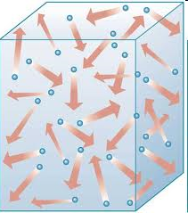
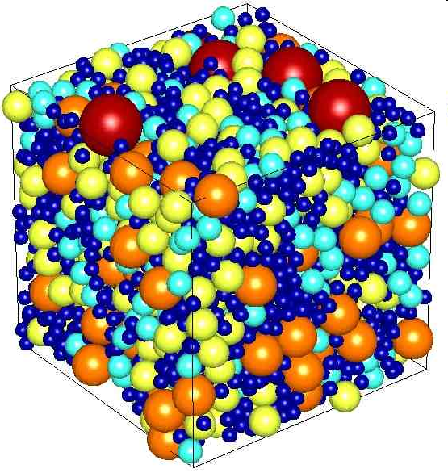
How much matter (mass) is inside per unit of volume

Slide 6
Population density

Slide 8
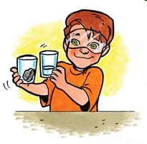

Slide 11
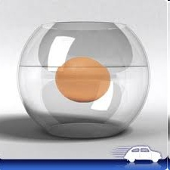
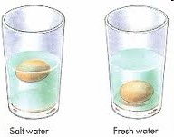

Slide 12
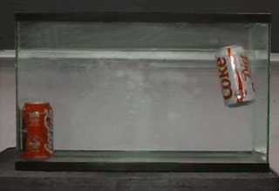
What do you think will happen when a regular coke can and a diet coke can are put in a tub of water? Float or sink, which one/both? Guess

Slide 13
sulfur lake underwater

