Slide 1
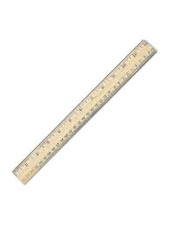
Measurement Tools
Metric Rulers

Slide 2
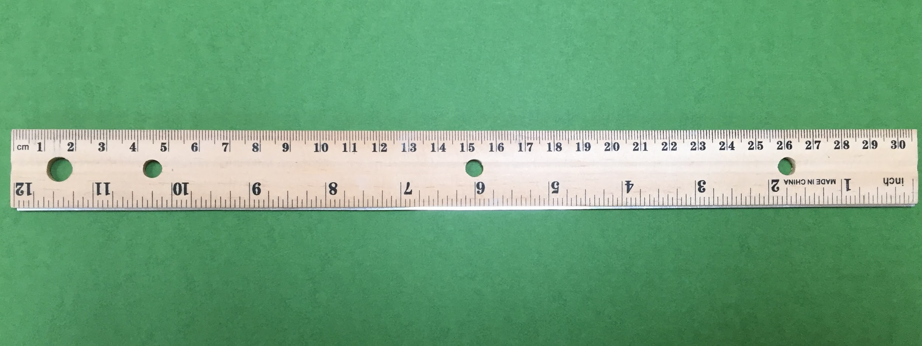
Length - Metric Ruler
Most rulers have English (or customary) and metric measurements. In science class you MUST always use metric measurements. Always hold the ruler so that you are looking at the side where the numbers go from 0 to 30. Those are centimeters! The side that goes from 0 to 12 is inches. DO NOT USE INCHES IN SCIENCE CLASS!

Slide 3
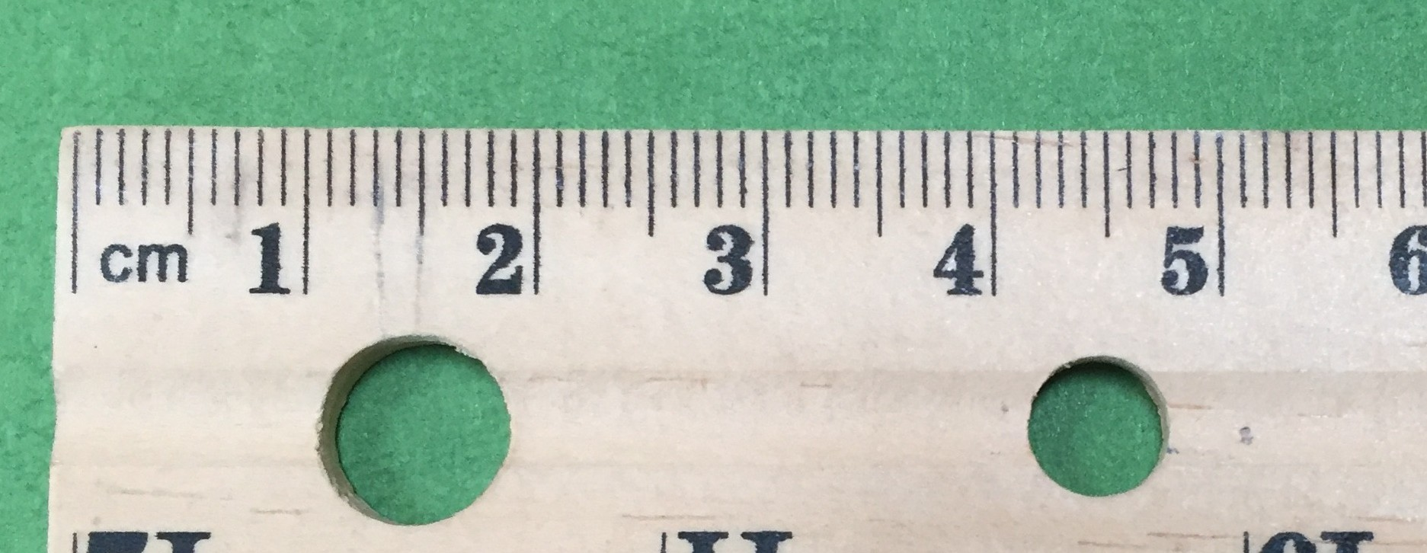
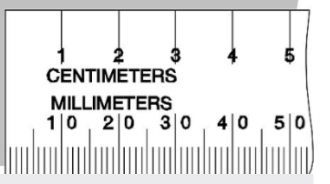
Length - Metric Ruler
On a metric ruler, the
numbers represent
centimeters. There are
ten equal spaces or
ten millimeters inside
each centimeter.

Slide 4
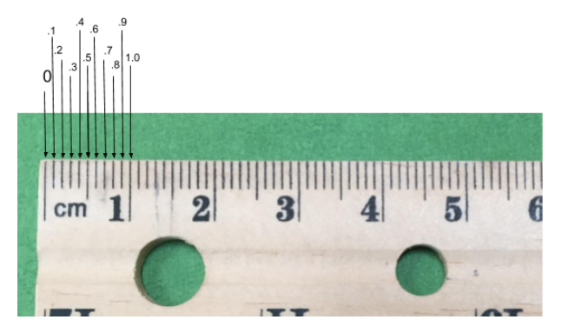
Length - Metric Ruler
Centimeters: If there
are ten equal spaces
in one centimeter, then
each space is worth
1/10 (one tenth) of a
centimeter. In decimals,
1/10 = 0.1
0.1
10
1.0
1 0
0

Slide 5
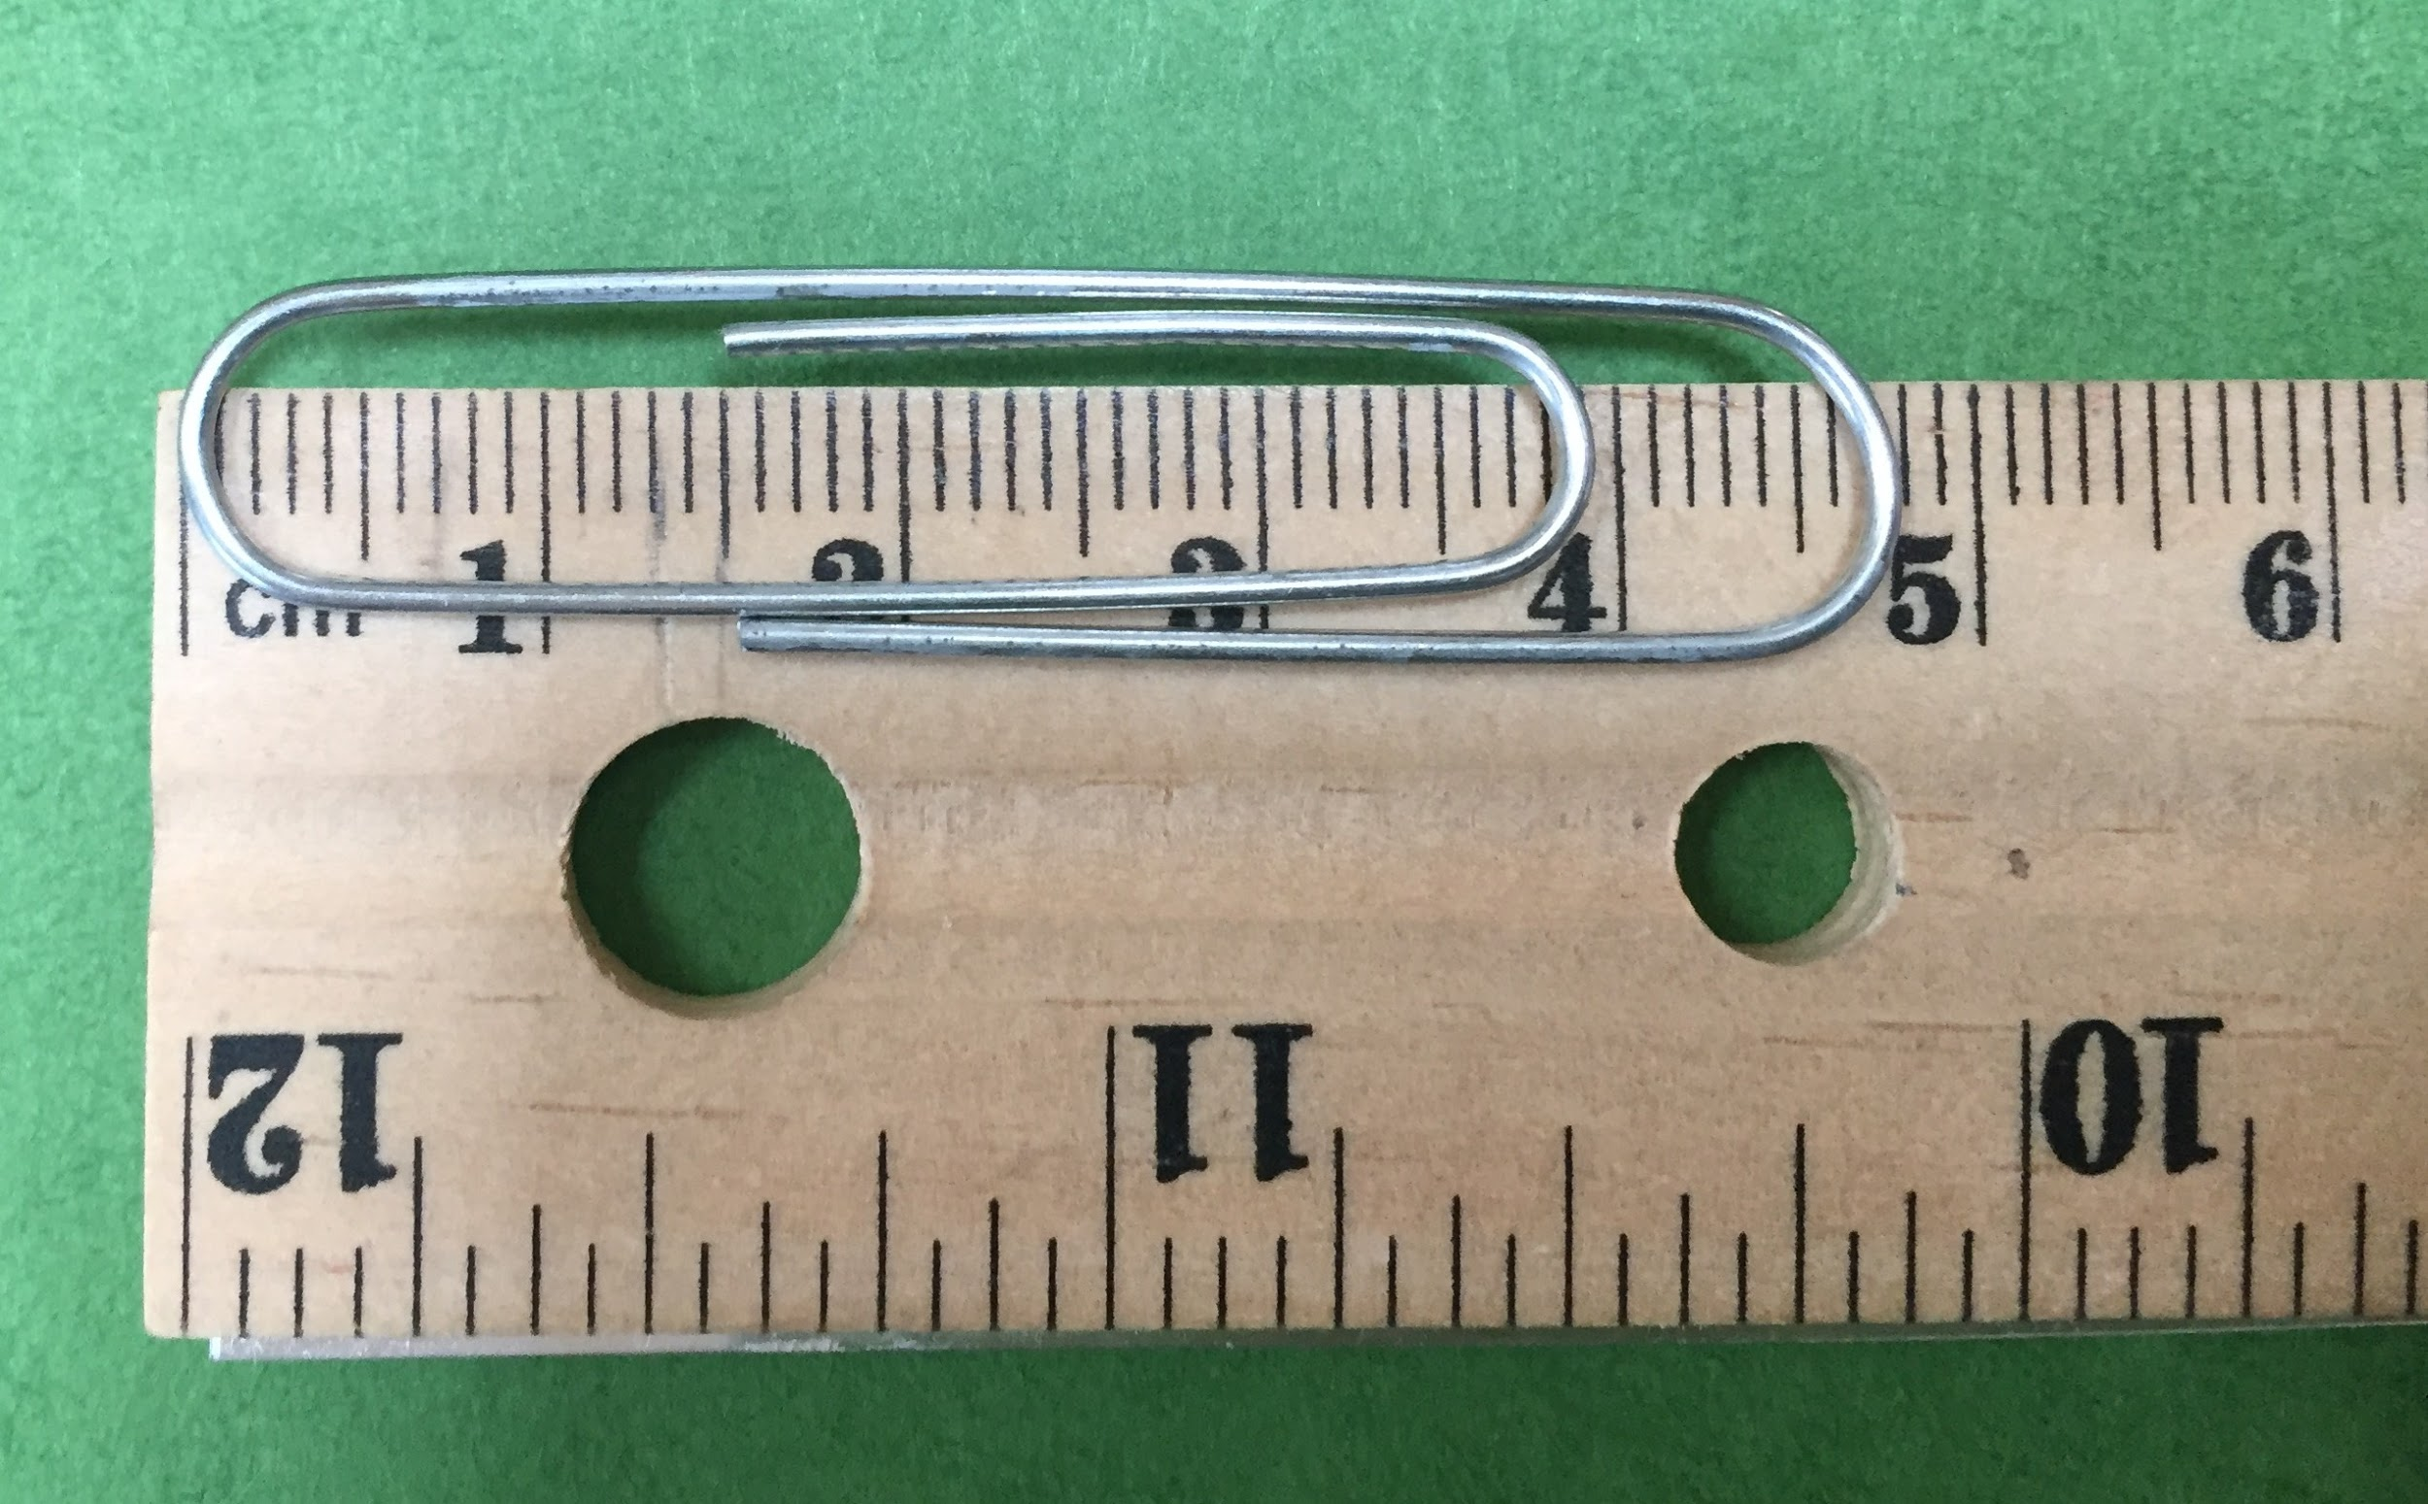
Length - Metric Ruler
The length of the paperclip
is 4 and 8/10 (or 8 little
lines). Metric measurements
will always be written as
decimals, NOT fractions.
The length of the paperclip
would be reported as 4.8 cm.
Note - the 7th little line is
covered by the paperclip, so
you can’t see 4.7.
Notice that “0” on the ruler is not right at the end of the wood.

Slide 6
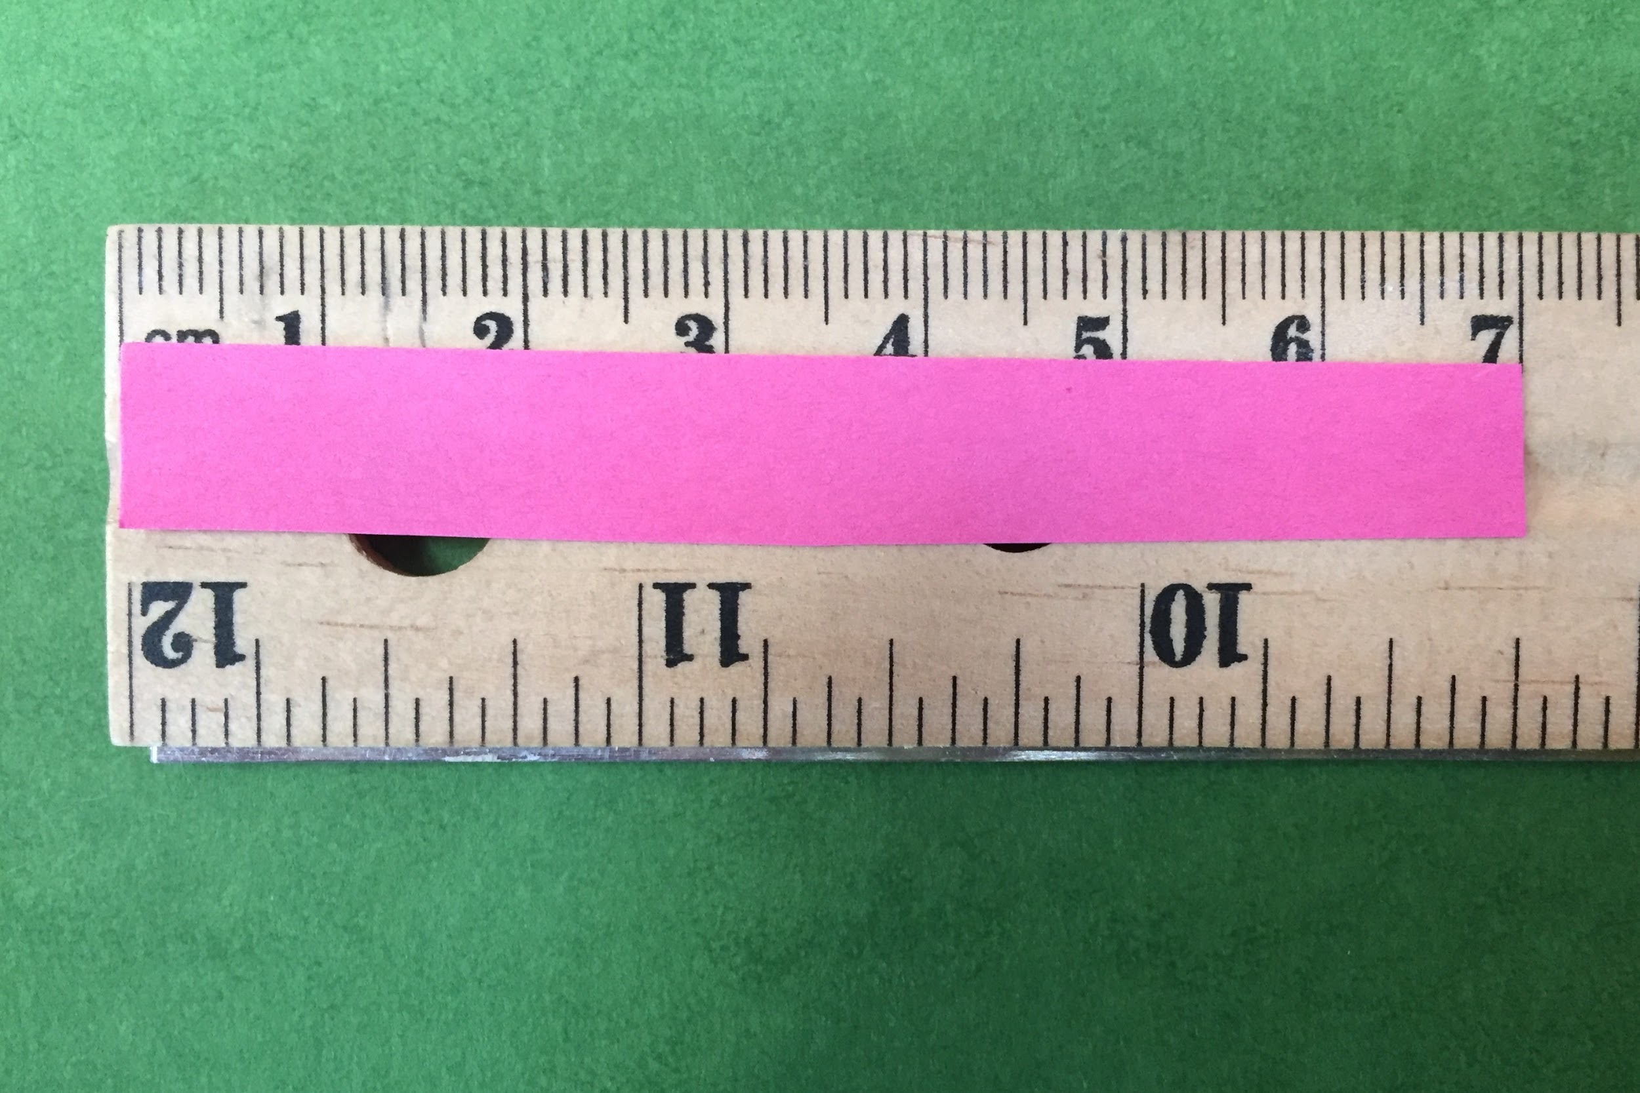
Length - Metric Ruler
Practice reading the length of
each strip of pink paper. Write
your answers on a piece of
scratch paper. Label each
measurement in centimeters
(cm).
The Length of paper A is _________ cm.

Slide 7
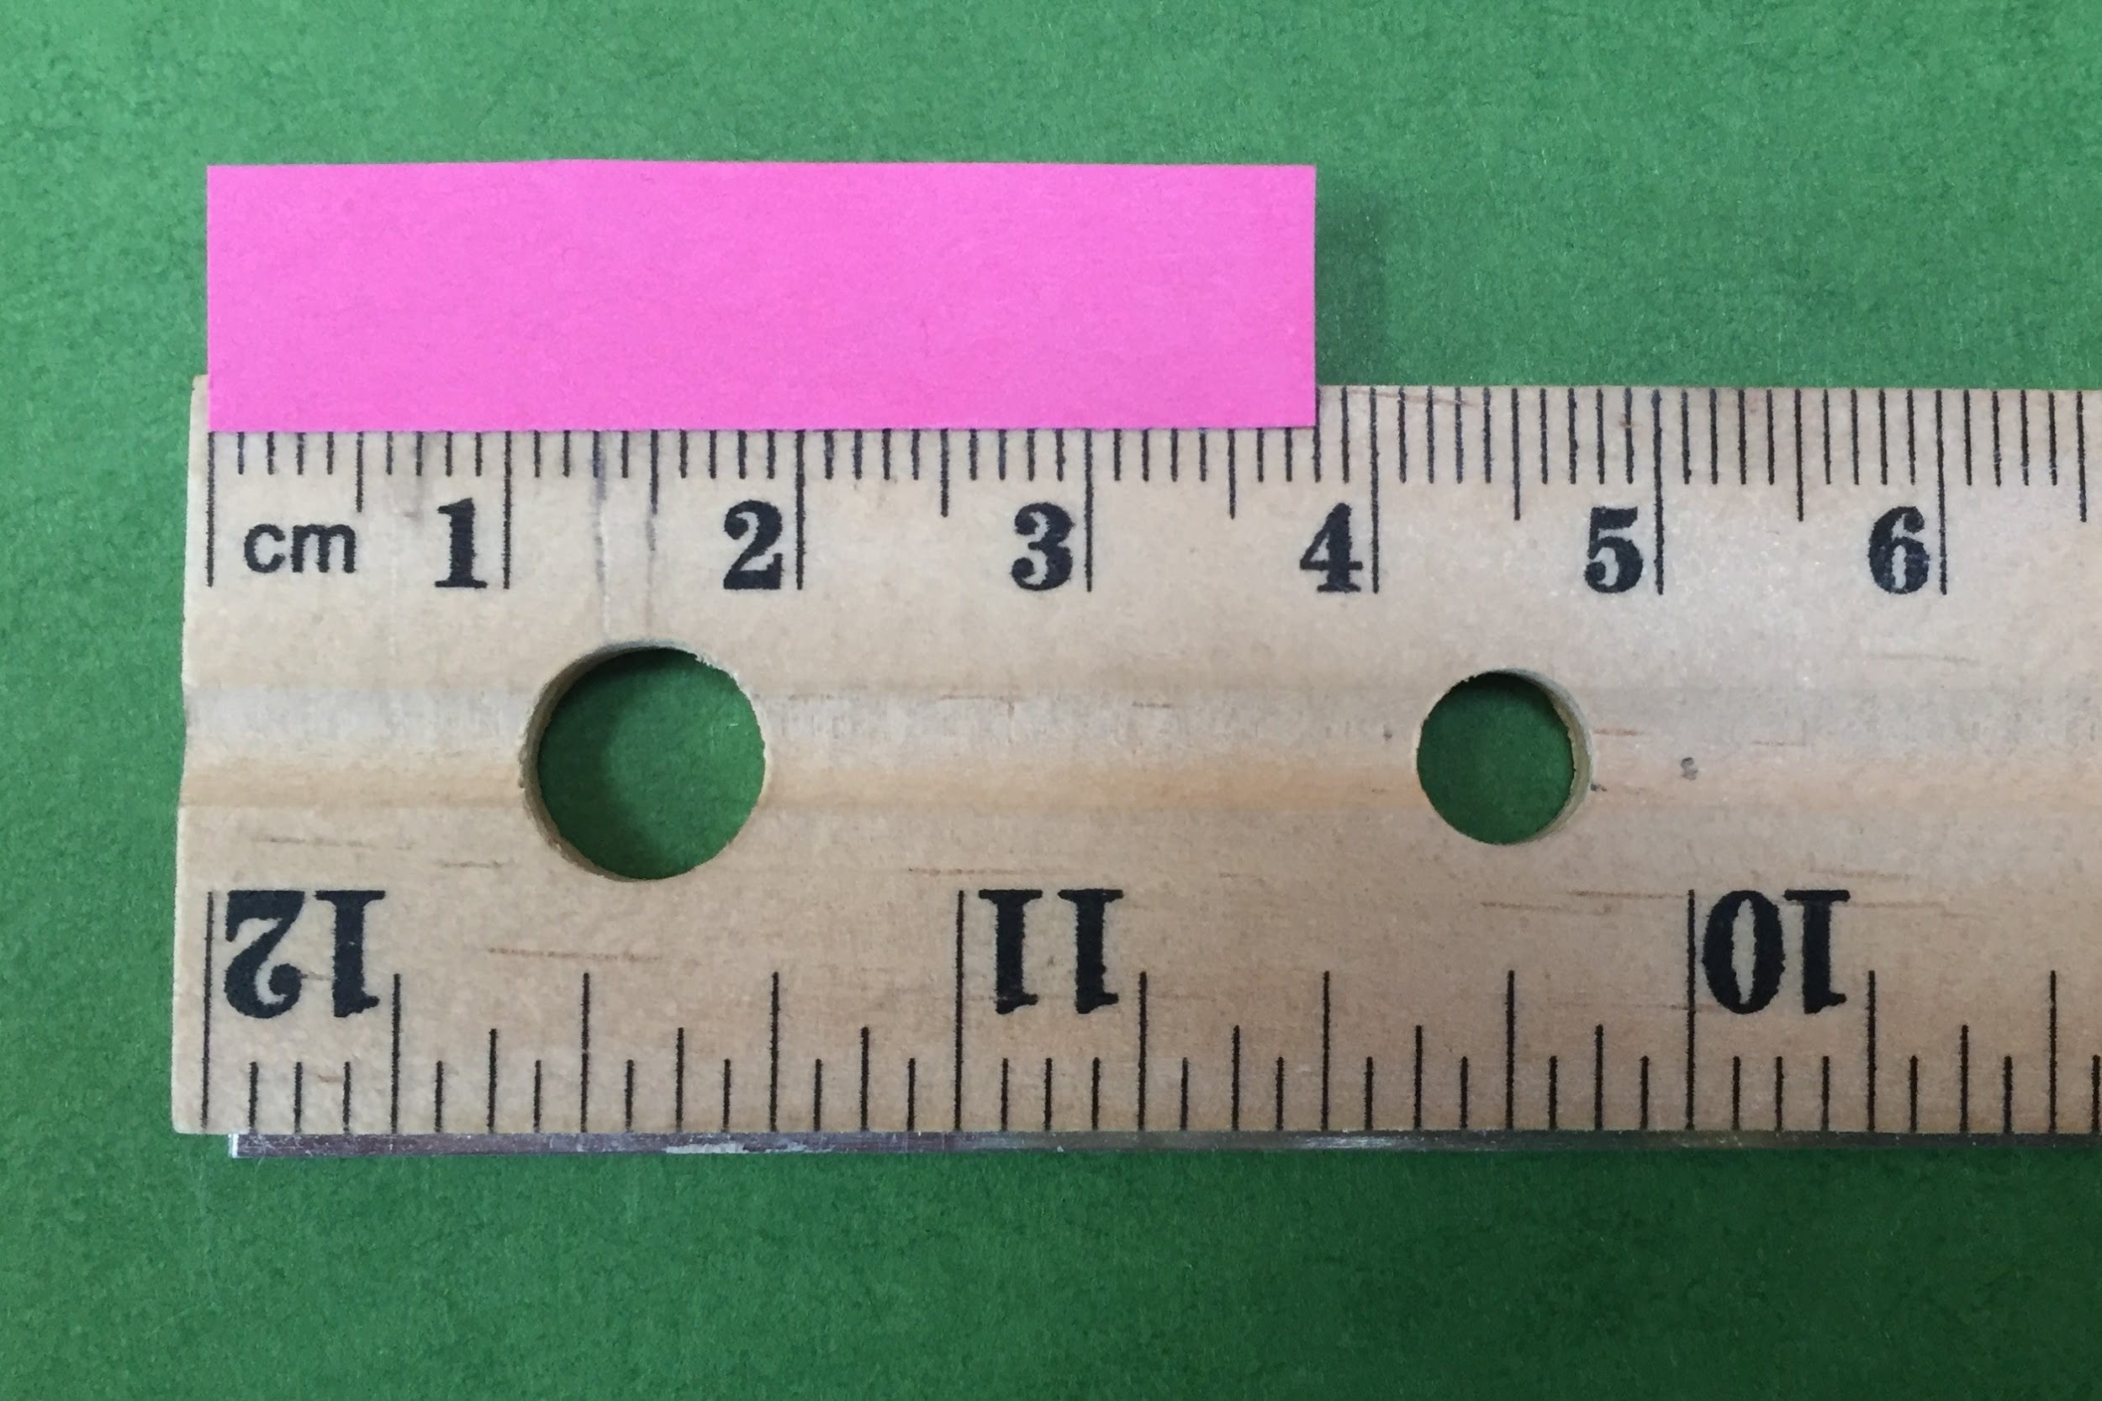
Length - Metric Ruler
Practice continued….
Practice reading the length of
each strip of pink paper. Write
your answers on a piece of
scratch paper. Label each
measurement in centimeters
(cm).
The Length of paper B is _________ cm.

Slide 8
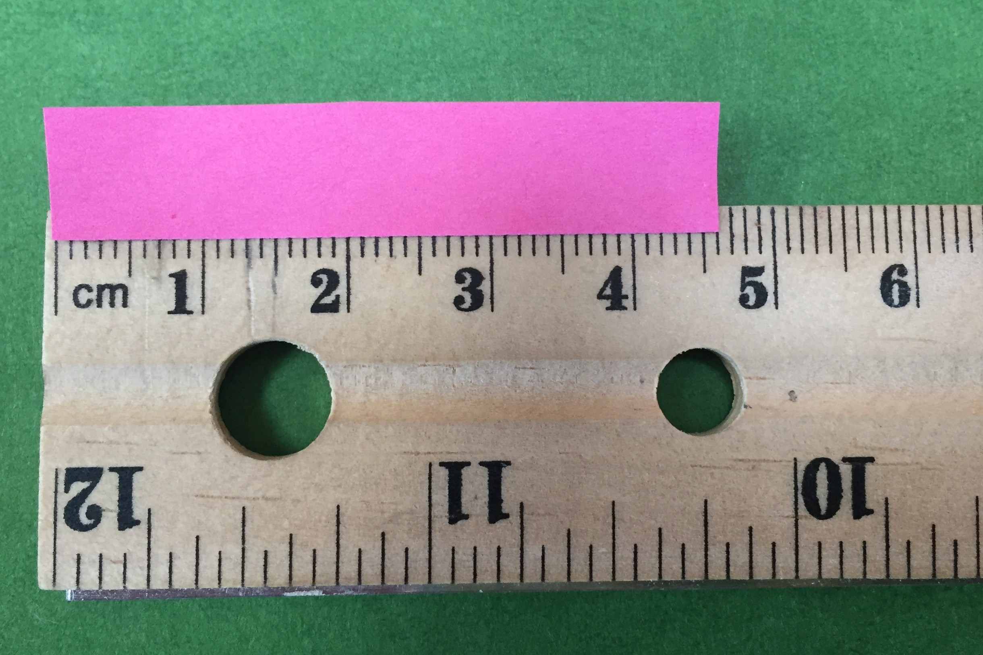
Length - Metric Ruler
Practice continued….
Practice reading the length of
each strip of pink paper. Write
your answers on a piece of
scratch paper. Label each
measurement in centimeters
(cm).
The Length of paper C is _________ cm.

Slide 9
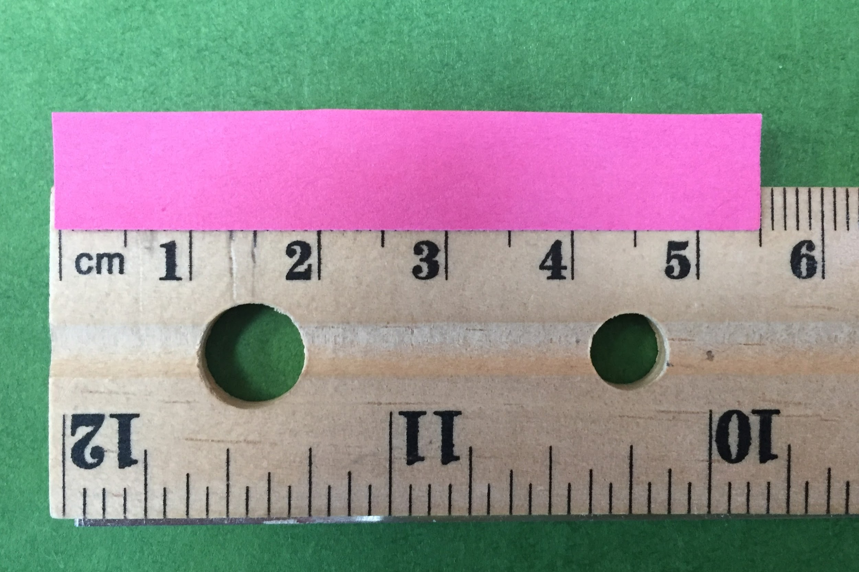
Length - Metric Ruler
Practice continued….
Practice reading the length of
each strip of pink paper. Write
your answers on a piece of
scratch paper. Label each
measurement in centimeters
(cm).
The Length of paper D is _________ cm.

Slide 10
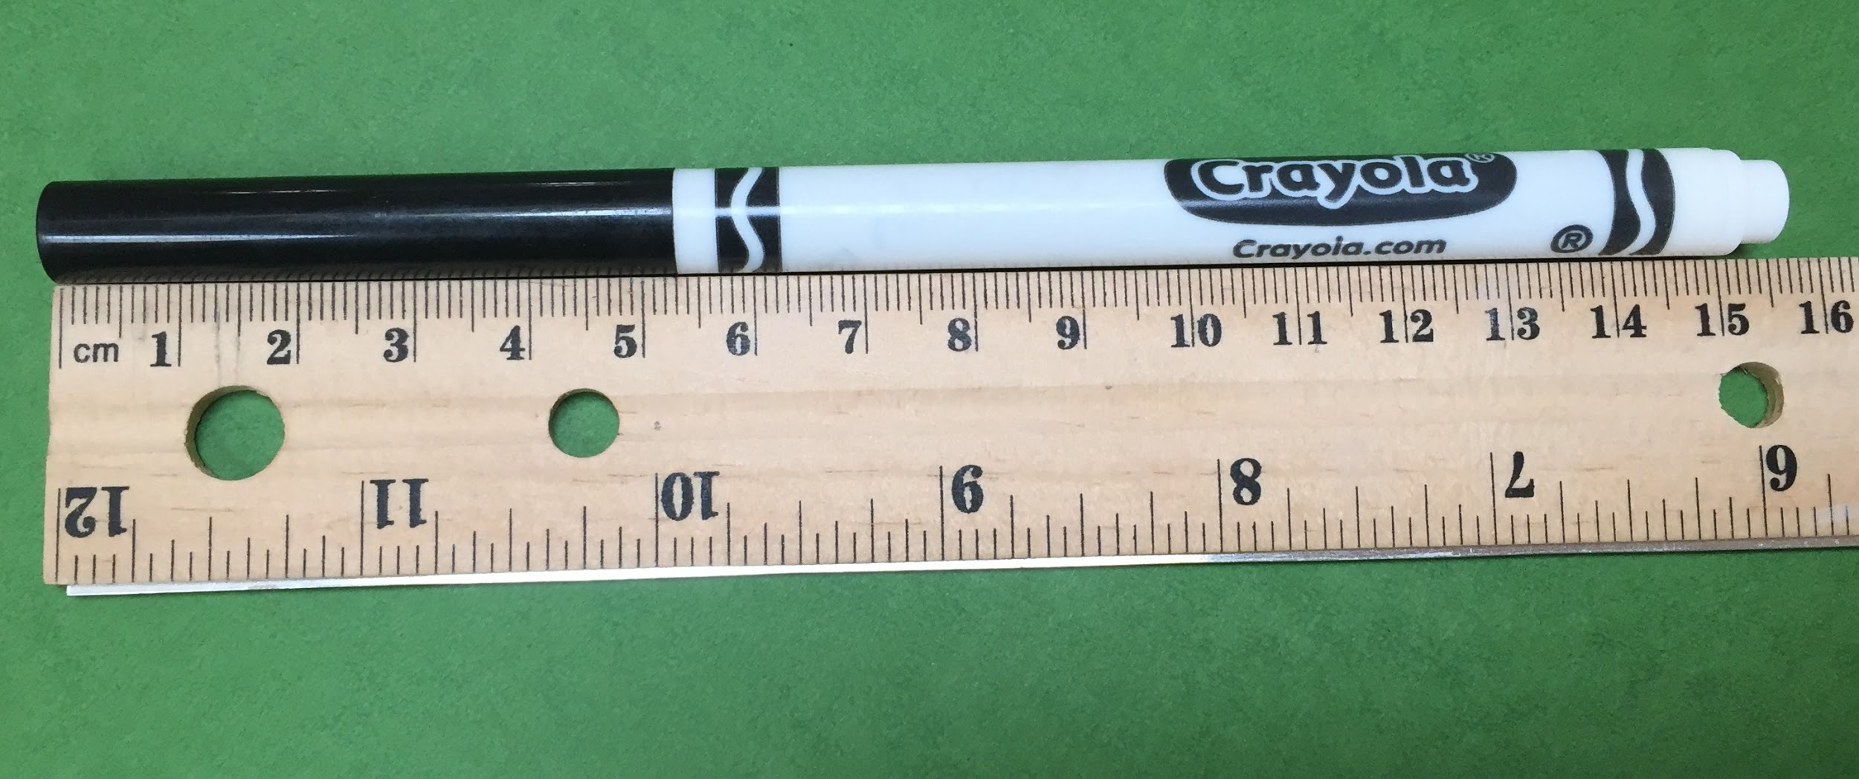
Length - Metric Ruler
What is the length of the marker? Place one end of the object at “0” on the ruler. Read the value at the other end of the object. NOTE - in the image it may be difficult to read the exact value because of the perspective from which the photo was taken. Read the length as closely as you can.

Slide 11
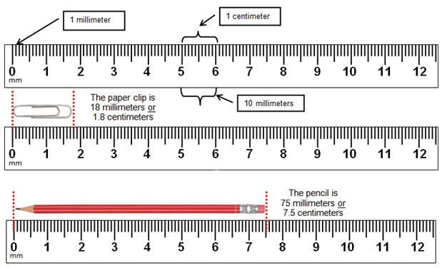
Length - Metric Ruler
Here is how
measurements
would be written
when reported in
centimeters or in
millimeters.

Slide 12
Length - Metric Ruler
What happens if the length is not right on a ruler line but is between two lines on the ruler? Read this slide in “Present” mode so that the image is larger and it is clear that the red arrow is not directly on a line of the ruler.

Slide 13
Length - Metric Ruler
The correct measurement is NOT 1.9 cm and it is NOT 2.0 cm because the arrow is not right on either line. You must estimate another digit. The length is 1.9 and a little bit more (but not as big as 2.0).
The purple line points to 1.9 cm. The green line points to 2.0 cm.

Slide 14
Length - Metric Ruler
The purple line points to 1.9 cm. The green line points to 2.0 cm. The answer is more than 1.9 and less than 2.0. Imagine there are ten more little spaces between 1.9 and 2.0. 1.90 1.95 2.00

Slide 15
Length - Metric Ruler
Looking at the original image, the red line possibly points at 1.98 or 1.99. The last digit is an estimate. If you write 1.9 or 2.0, those answers would be marked incorrect. Anything between 1.95 and 1.99 would be OK. 1.98
Acceptable answer : 1.98 cm 1.90 1.95 2.00

Slide 16
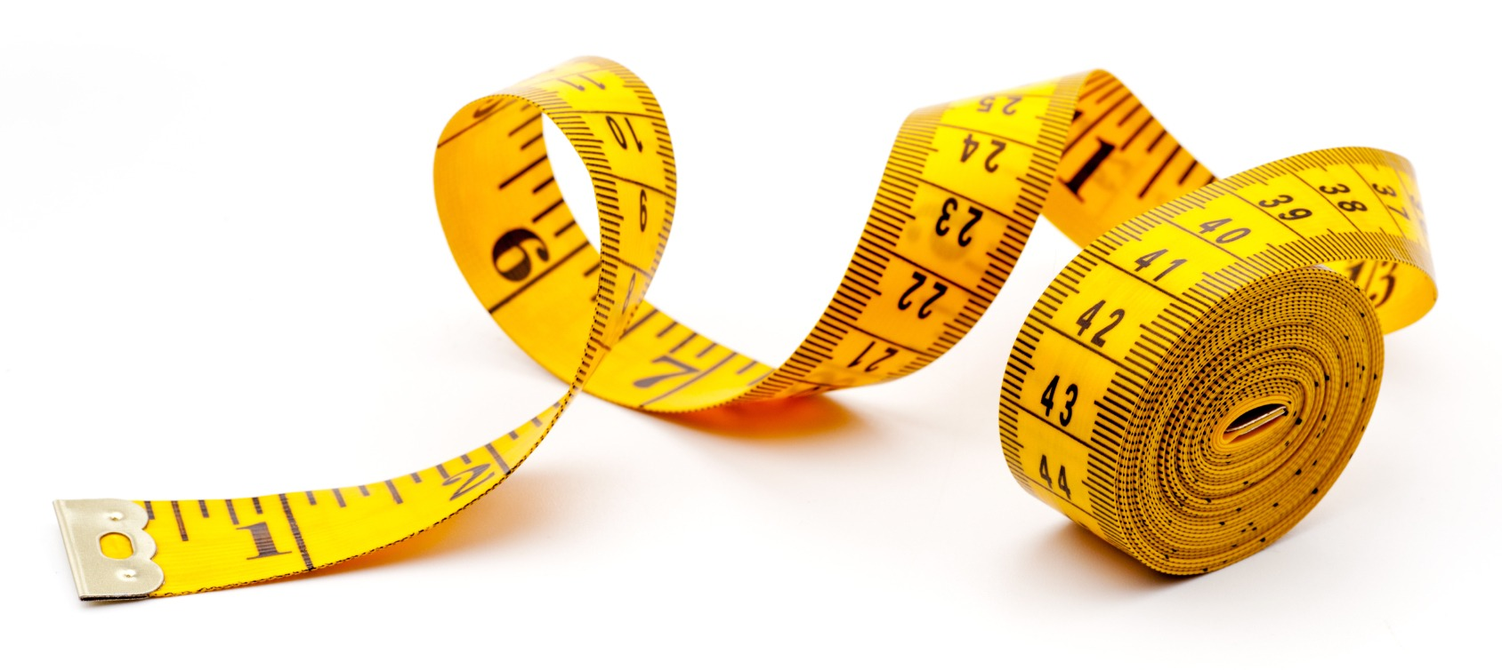
The End

