Slide 1
Ch2 Characteristics of Life Write in your lab book 7th grade Science 2015 Write everything: # 1 - #46
Use the textbook to fill in the notes
Write clearly. This is an important chapter – it will tie into Chemistry!
Ms Toal
Ps. These notes go in order of the textbook

Slide 2
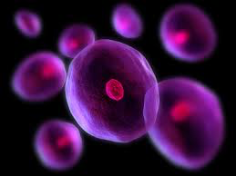
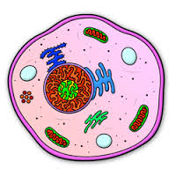
Chapter 2 p. 52/53
All living things are _____________________________________.
A cell is ___________ and __________ unit of life.
All cells are surrounded by ______________________________.
All thing things are able to __________________________.
Homeostasis - __________________________________________.
Living things reproduce __________________________________.
Living things make offspring by either __________ or ________.
Sexual reproduction - ____________________________________.
Asexual reproduction - _________________________________.

Slide 3
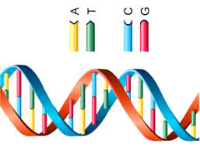
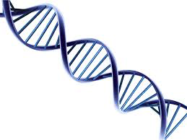
Living things have DNA p. 54,55
DNA = Deoxy________________________________________.
DNA carries _______ when reproducing, they _________(traits).
The passing of these traits is _____________________________.
Living things use energy to carry out _____________________
Ex1: ___________________ ex2: ______________ ex 3:___________.
Metabolism - __________________________________________.

Slide 4
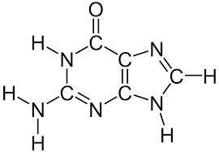
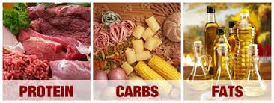
Living things have DNA p. 55-59
Living things grow and develop.
a) single cell organisms grow as ____________________.
b)multicellular organisms grow when numbers of _____.
Putting it all together:
Nutrients are made of ____________.
A molecule is when 2 of ______________________________.
Compounds are ______________________________________.
All living things contain 6 elements: ___ ___ ___ ___ ___ ___ .
Proteins ______ or ________ chemical reactions in cells.

Slide 5
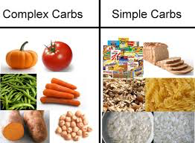
Carbohydrates p 59…
Carbohydrates - ______________________________________.
Carbohydrates provide and ____________________________.
Cells break down carbohydrates ________________________.
2 kinds are : __________________ and ___________________.
Simple (ex) - ____________________________________________
Complex (ex) - _________________________________________.

Slide 6
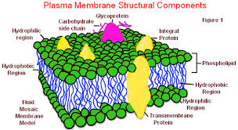
Lipids p. 60
Lipids are ______________________________________________.
All cells are surrounded by a _________________________.
A Cell membrane helps ____________________ and _________.
Phospholipids: form much of ____________________________.
Phospholipids: head - __________________ tail - ___________.
ATP – energy _______________________molecule of ________.
Nucleic acids: made up of ________________________________.

Slide 7
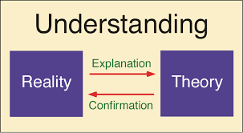
Check for understanding
32. Read summary on page 51
33. Answer “understanding concept” 1 – 5
1) _____________________________________________________
2) _______________________________________________________
3) _______________________________________________________
4) _______________________________________________________
5) ______________________________________________________.

Slide 8
Last couple slides : Vocab
34) Cell - _______________ 35) homeostasis - _____________
36) Sexual production - ________ 37) asexual production - _____
38) Metabolism - _______________ 39) producer - _____________
40) Consumer - ________________ 41) decomposer -___________
42) Protein - __________________ 43) carbohydrate - __________
44) Lipid - ________________ 45) ATP - _____________________
46) Nucleic acids - ________________________

