Slide 1
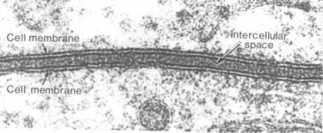
Cellular Transport Notes
Ms Toal

Slide 2
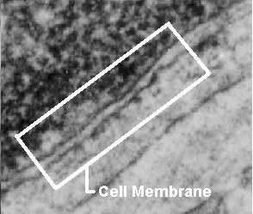
About Cell Membranes
All cells have a cell membrane
Functions:
Controls what enters and exits the cell to maintain an internal balance called homeostasis
Provides protection and support for the cell
TEM picture of a real cell membrane.

Slide 3
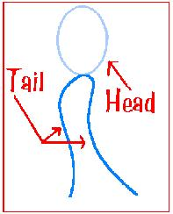
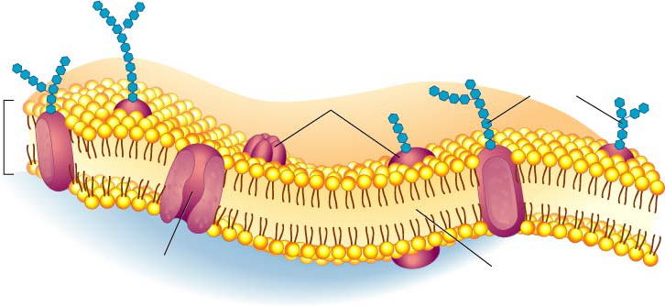
About Cell Membranes (continued)
Structure of cell membrane
a) Lipid Bilayer -2 layers of phospholipids
Phosphate head is polar (water loving)
Fatty acid tails non-polar (water fearing)
b).Proteins embedded in membrane
Phospholipid
Lipid Bilayer

Slide 4
Polar heads love water & dissolve.
Fluid Mosaic Model of the cell membrane
Non-polar tails hide from water.
Carbohydrate cell markers
Proteins

Slide 5
About Cell Membranes (continued)
4. Cell membranes have pores (holes) in it
Selectively permeable: Allows some molecules in and keeps other molecules out
The structure helps it be selective!
Pores

Slide 6
DRAW THIS IN PICTURE IN THE BLANK RECTANGULAR BOX
Outside of cell
Carbohydrate
chains
Proteins
Lipid
Bilayer
Transport
Protein
Phospholipids
Inside of cell
(cytoplasm)
Animations
of membrane structure
Go to Section:

Slide 7
Types of Cellular Transport
Weeee!!!
Passive Transport
cell doesn’t use energy
Diffusion
Facilitated Diffusion
Osmosis
Active Transport
cell does use energy
Protein Pumps
Endocytosis
Exocytosis
high
low
This is gonna be hard work!!
high
low

Slide 8
Passive Transport
cell uses no energy
molecules move randomly
Molecules spread out from an area of high concentration to an area of low concentration.
(High→Low)
Three types of passive transport:

Slide 9
3 Types of Passive Transport
Diffusion
Facilitative Diffusion – diffusion with the help of transport proteins
Osmosis – diffusion of water

Slide 10
Passive Transport: 1. Diffusion
Diffusion: random movement of particles from an area of high concentration to an area of low concentration.
(High to Low)
Diffusion continues until all molecules are evenly spaced (equilibrium is reached)-Note: molecules will still move around but stay spread out.
http://bio.winona.edu/berg/Free.htm

Slide 11
Passive Transport: 2. Facilitated Diffusion
A
B
2. Facilitated diffusion: diffusion of specific particles through transport proteins found in the membrane
Transport Proteins are specific – they “select” only certain molecules to cross the membrane
Transports larger or charged molecules
Facilitated diffusion (Channel Protein)
Diffusion (Lipid Bilayer)
Carrier Protein

Slide 12
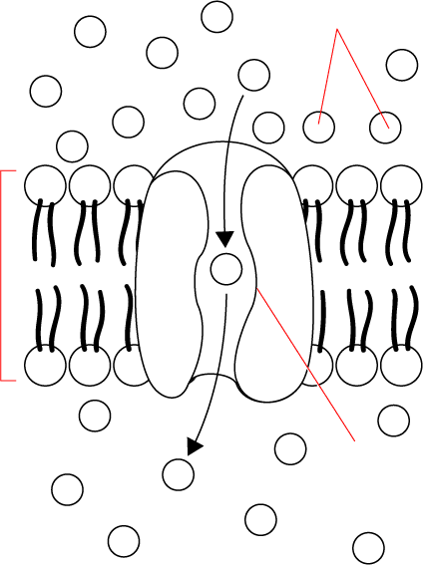
Passive Transport: 2. Facilitated Diffusion
Glucose
molecules
Cellular Transport From a-
High
High Concentration
Channel Proteins animations
Cell Membrane
Low Concentration
Protein
channel
Low
Transport Protein
Through a →
Go to Section:

Slide 13
Passive Transport: 3. Osmosis
Osmosis animation
3.Osmosis: diffusion of water through a selectively permeable membrane
Water moves from high to low concentrations
Water moves freely through pores.
Solute (green) to large to move across.

Slide 14
Active Transport
cell uses energy
actively moves molecules to where they are needed
Movement from an area of low concentration to an area of high concentration
(Low → High)
Two Types of active transport:

Slide 15
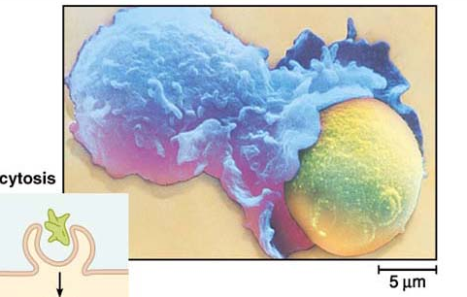
Types of Active Transport – draw this in blank space
1. Endocytosis: taking bulky material into a cell
Uses energy
Cell membrane in-folds around food particle
“cell eating”
forms food vacuole & digests food
This is how white blood cells eat bacteria!

Slide 16
Types of Active Transport
3. Exocytosis: Forces material out of cell in bulk
membrane surrounding the material fuses with cell membrane
Cell changes shape – requires energy
EX: Hormones or wastes released from cell

Slide 17
Effects of Osmosis on Life
Osmosis- diffusion of water through a selectively permeable membrane
Water is so small and there is so much of it the cell can’t control it’s movement through the cell membrane.

